Slide 1


Bug Hunters
Chatbot with customizable Voice
Team Leader:
Sandhiya
Team members:
Martina romisha
Madhan raj
Kokil
Mugilanandam

Slide 2

Overall plan
Our topic is ‘Chatbot with customizable Voice using Rasa open source software’. We actually train a model by modifying some domains and NLU yml files.With Anaconda software we have installed Rasa.We planning to record our team mates voices to train the voice synthesizer.We have successfully trained the way the model should greet the user .Further we have collected bunch of frequently asked questions about COVID by the common people

Slide 3
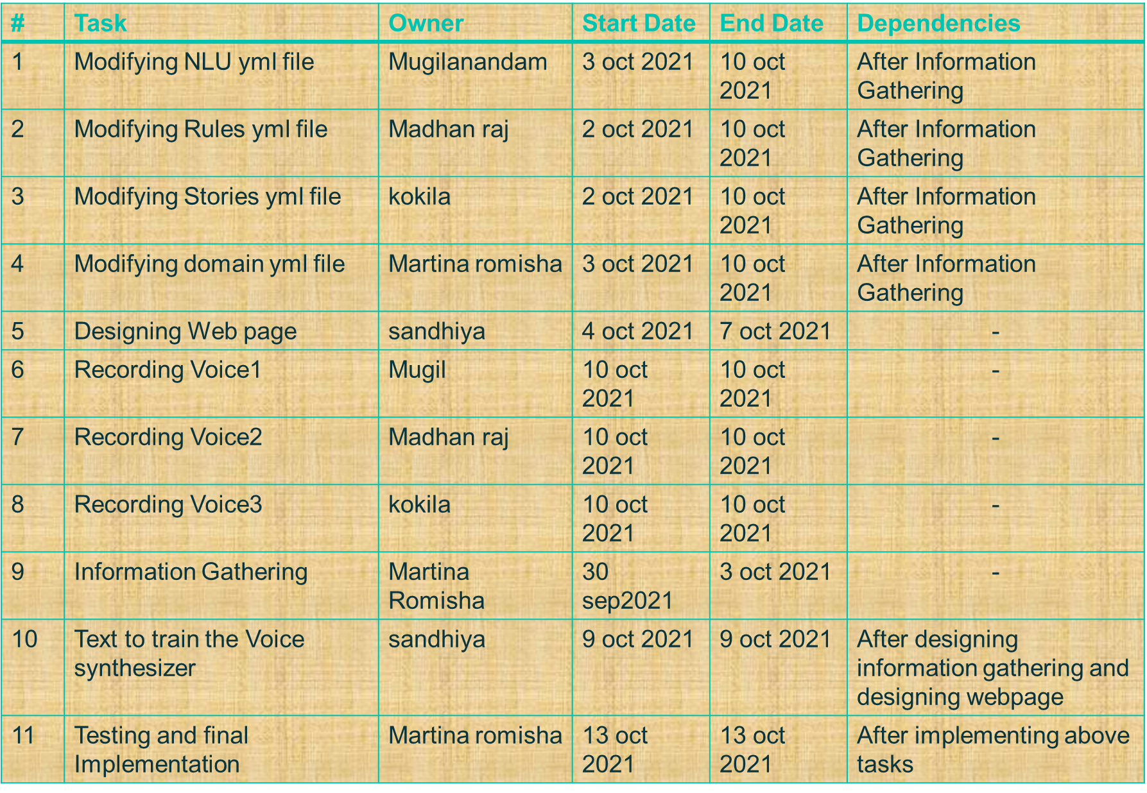

Slide 4
Thank you…!!!

